Slide 1

TOURISM RELIEF FUND
NEDLAC
01 MAY 2020

Slide 2
TOURISM RELIEF FUND
Once-off grant for SMMEs to mitigate COVID-19 impact.
R200m relief fund capped at R50 000 per entity
Restricted use: fixed costs, operational costs, supplies and other pressure cost items
ELIGIBILITY CRITERIA
All businesses in compliance with Tourism Broad Based Black Economic Empowerment (B-BBEE) Codes of Good Practices approved by the Minister of Trade and Industries in 2015.
Eligible categories:
  Accommodation establishments: Hotels, Lodges, Bed and Breakfast (B&B’s), Guest Houses and Backpackers. •
  Hospitality and related services: Restaurants (not attached to hotels); Conference venues (not attached to hotels); Professional catering; and Attractions •
  Travel and related services: Tour operators; Travel agents; Tourist guiding; Car rental companies; and Coach Operators.

Slide 3
QUALIFYING CRITERIA
All SMME’s and Exempted Micro Enterprise (EME) defined in terms of the Amended Tourism B-BBEE Sector Code, 2015.
Registered business (CIPC)
Tax compliant
Compliant with the minimum wage requirements.
UIF Registered
Existing tourism-specific establishment as outlined in the scope of application
Suppliers and intermediaries are not eligible
In business for one year financial year or more
  Proof that the relief is required as a result of the impact of COVID-19.
  Must submit latest statements of financial position, financial performance and cash flows.
  Must submit 6 months bank statements.
Grading certificate or proof of application to be graded for accommodation establishments

Slide 4
ROLES AND RESPONSIBILITIES
Department of Tourism: Management of applications, Pre-screening, Monitoring and evaluation.
Panel of Experts: Evaluation and due diligence by Experts.
South African Tourism: Disbursement of approved grants within 7 days.
IMPLEMENTATION READINESS
Applications Window opened on the 7th April 2020.
Applications Window closes 31 May 2020
22 April 2020 update: 3240 Applications ready for evaluation
500 Pre-screened.
Solidarity and Afriforum brought urgent applications to court on the basis that the application of B-BBEE and the Tourism Sector Code as qualifying criteria for the Fund are racially discriminatory and therefore unconstitutional.
The two cases were consolidated and heard on 28 April 2020.
Pending court judgment, there no decisions taken on the applications received.
The court decision was given on the 30th April 2020 in favour of the department.

Slide 5
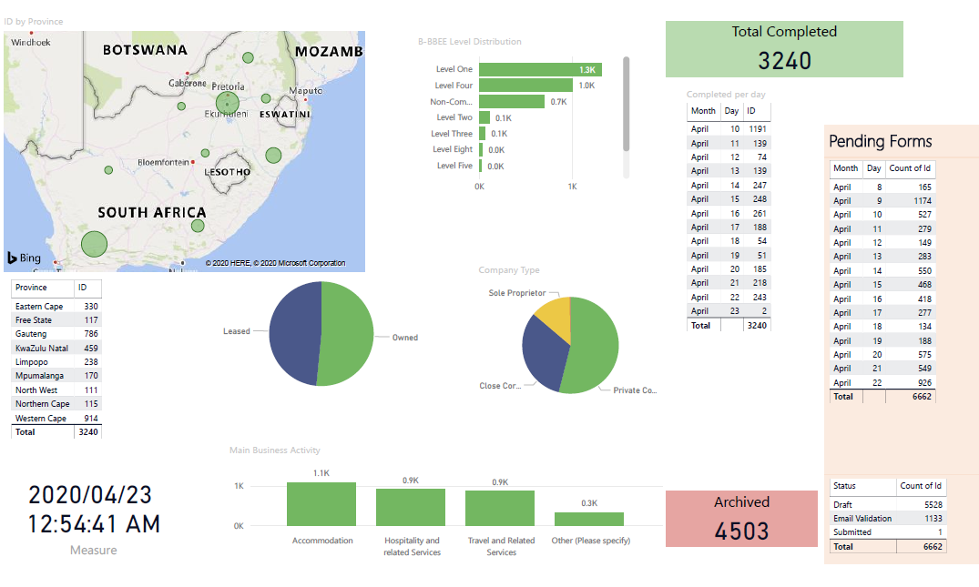

Slide 6
RISK MANAGEMENT
MONITORING AND EVALUATION
The Department will monitor the utilization of granted funds in order to be sure that it is used for what it was intended for
Declined applications due to non-compliance, will be supported to be compliant in order to be able to access funding support in the future
Verification of CIPC registrations and directors of companies
Local government validation of existence of business (e.g. accommodation and Restaurants)
Proof of registration in relation to the service provided, eg tourist guiding

Slide 7
THANK YOU

